Slide 1
Unit - 4
Optical Modulators, Switches and OEIC’s

Slide 2
Introduction
Modulator – A device which changes the irradiance or direction of the light passing through it.
General types of modulator –
Mechanical choppers
Passive/dye modulators
Electro-optic modulators
Acousto-optic modulators
Magneto-optic modulators

Slide 3
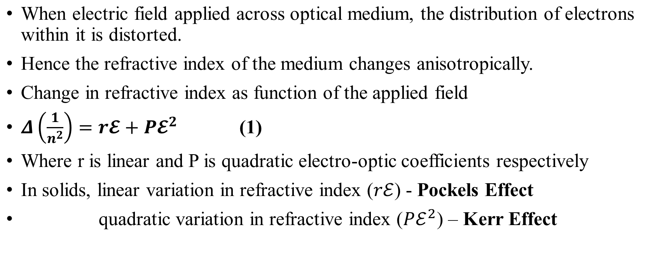
Electro-optic Effect

Slide 4
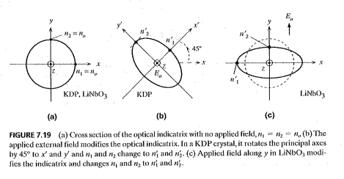
Effect of electric field on refractive index
Crystal | Without field | With field
GaAs | Optical isotropic nx=ny=nz | birefrengent
KDP | Uniaxial (nx=ny )< nz | Biaxial Ez field resulted in 45degree rotation nx1<ny1
LiNbO3 | Uniaxial (nx=ny)<nz | Biaxial nx1<ny1

Slide 5
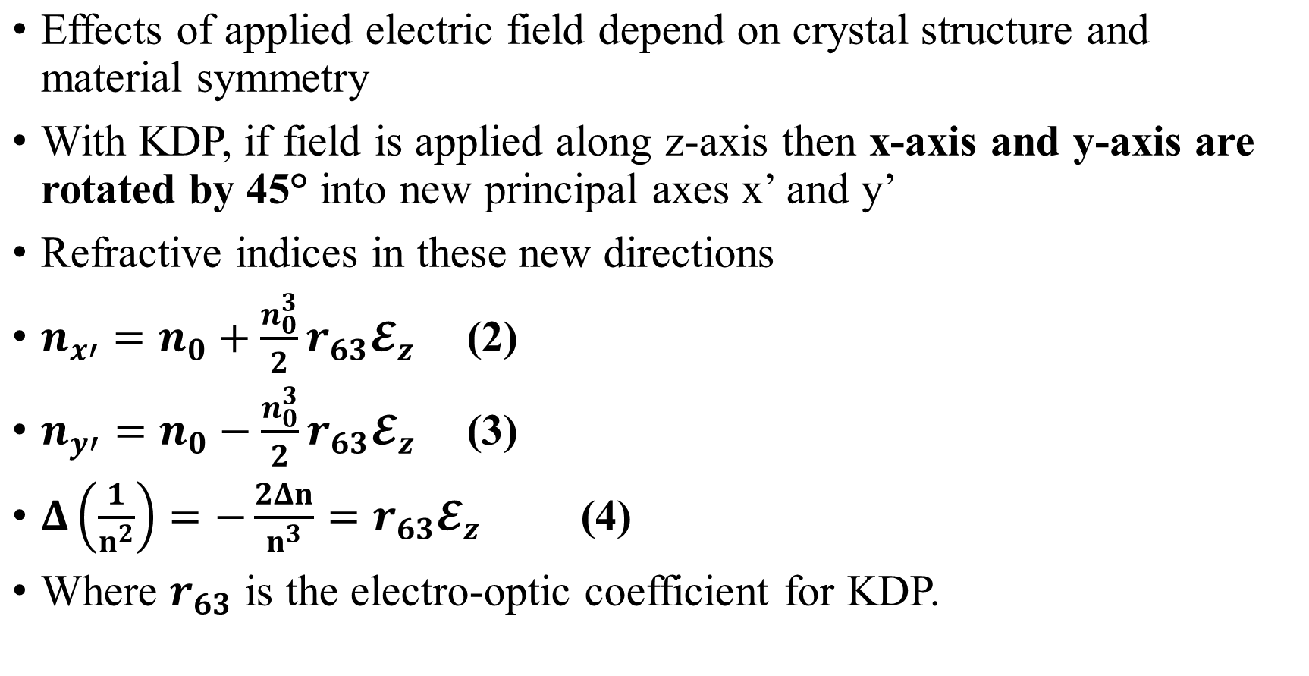
Pockels Effect

Slide 6
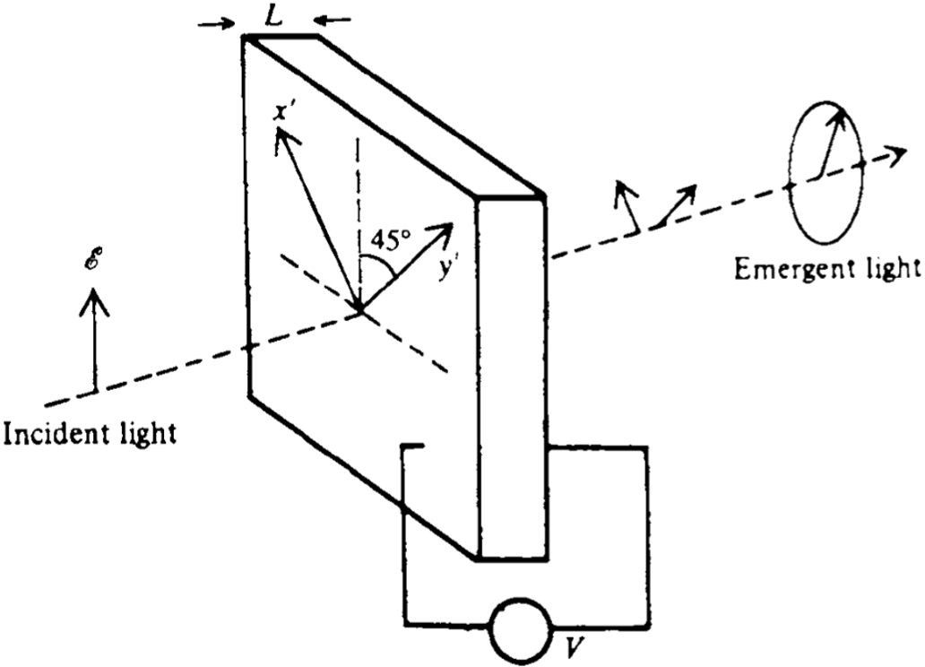
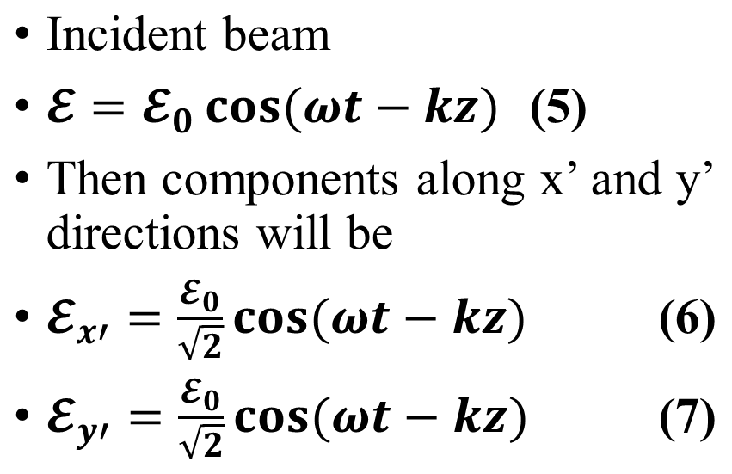
Pockels Effect

Slide 7
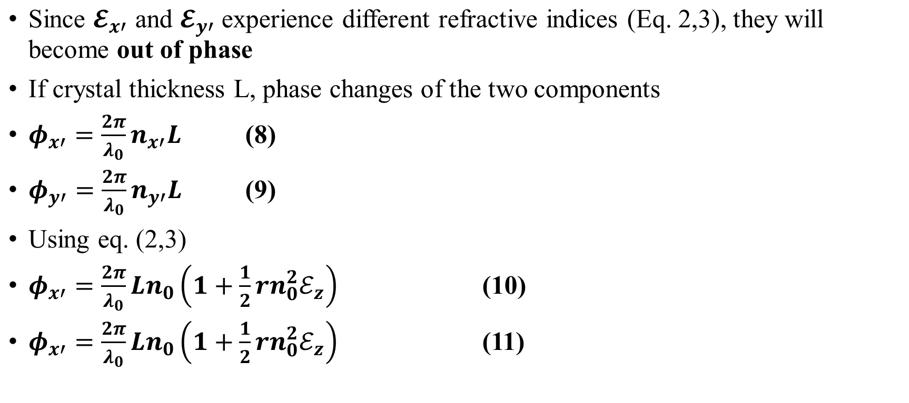
Pockels Effect

Slide 8
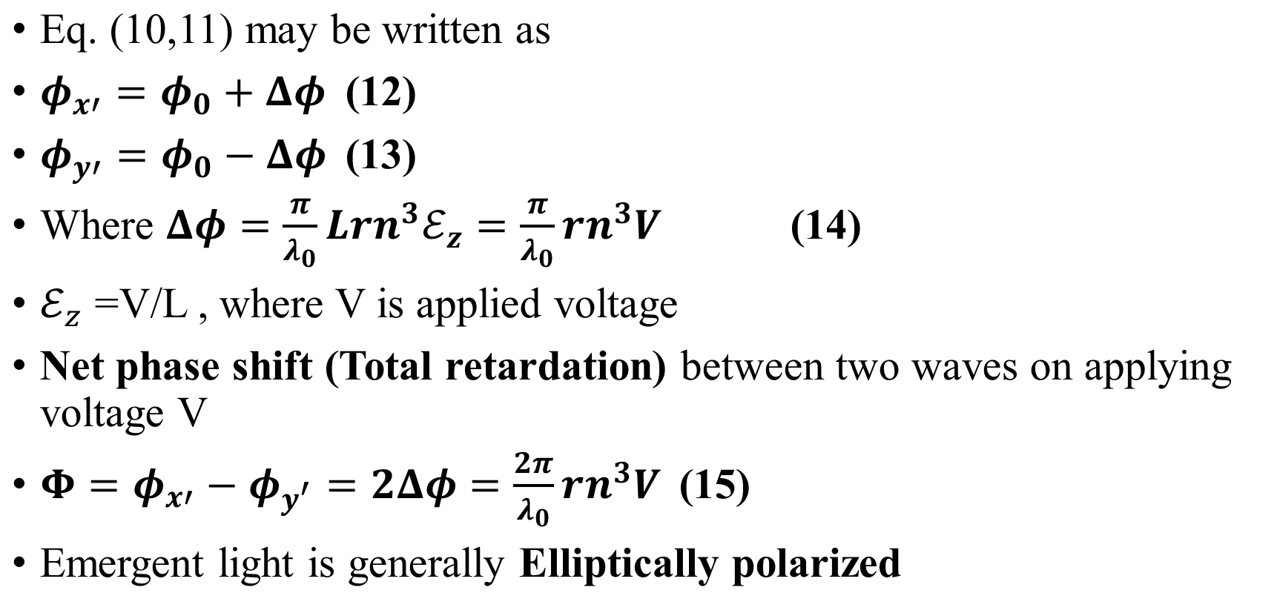
Pockels Effect
•

Slide 9
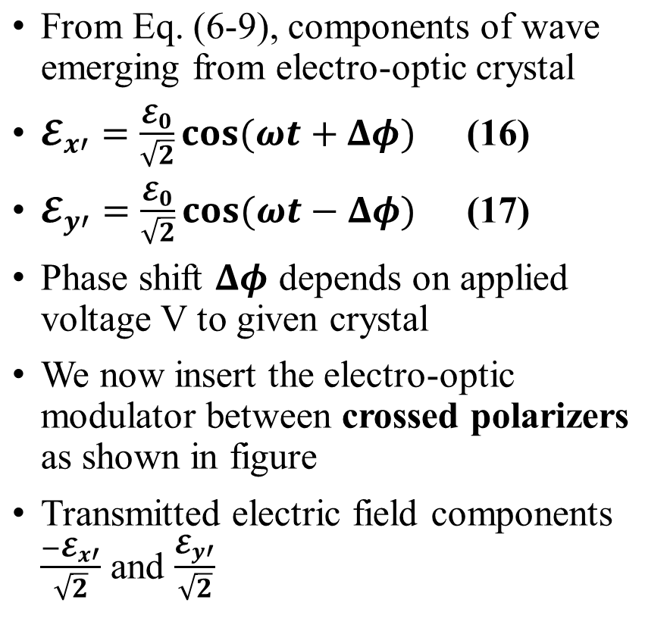
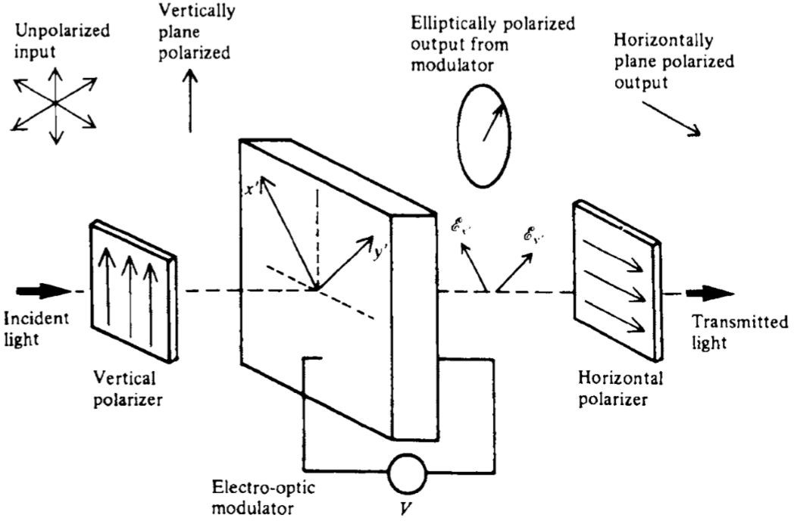
Pockels Cell Modulator

Slide 10
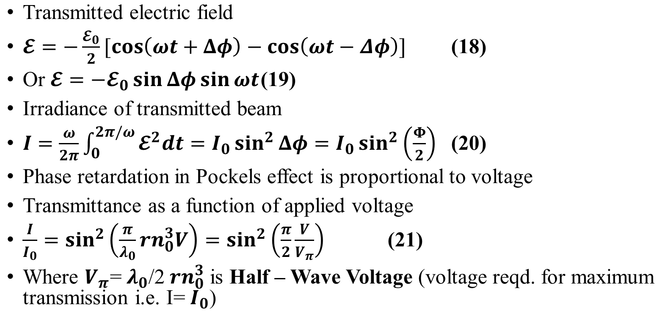
Pockels Cell Modulator

Slide 11
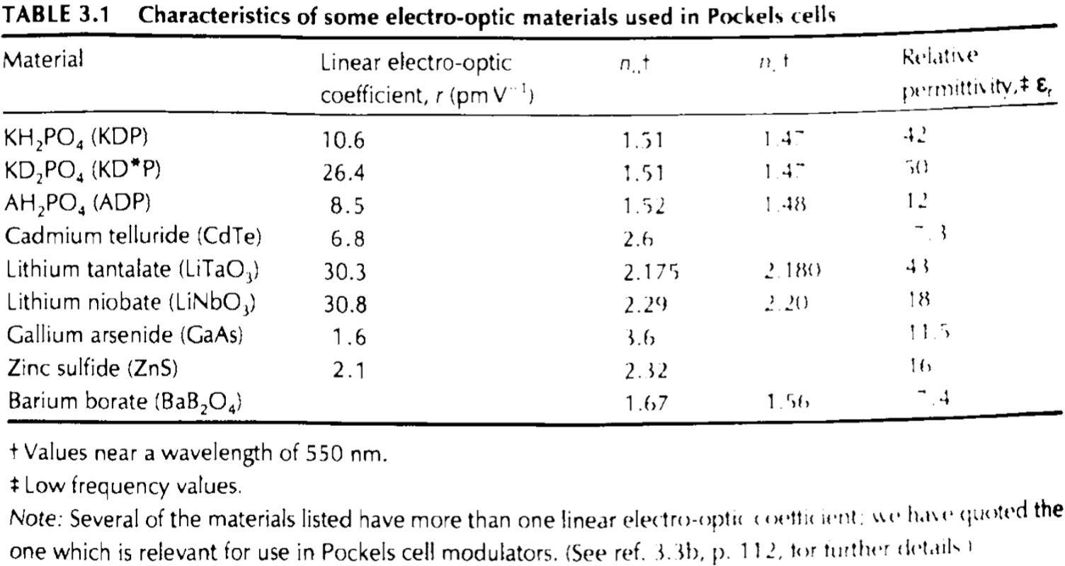
Pockels Cell Modulator

Slide 12
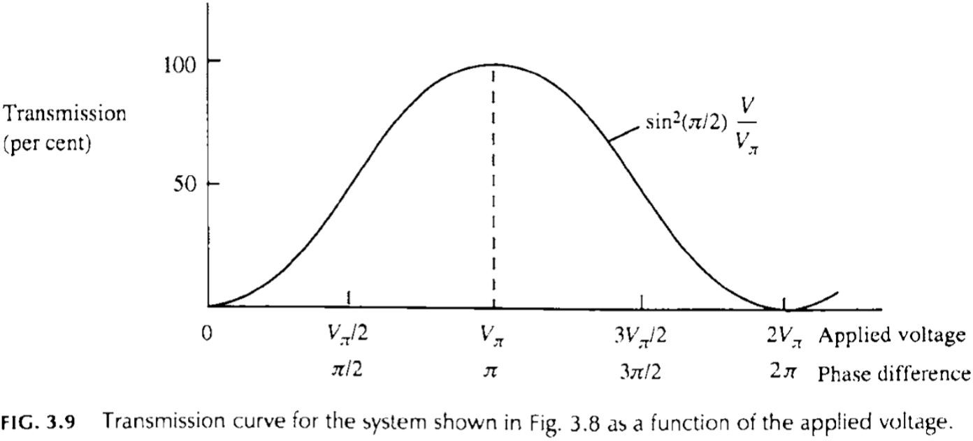
Pockels Cell Modulator
Transmittance of Pockels’
electro-optic modulator can be altered by the application of voltage along direction of propagation
Modulation is not linear. For small voltages, transmitted irradiance is proportional to V²
Effectiveness enhanced by including quarter-wave plate in the beam between initial polarizer and modulator
Introduces phase difference of π/2 between two polarized components

Slide 13
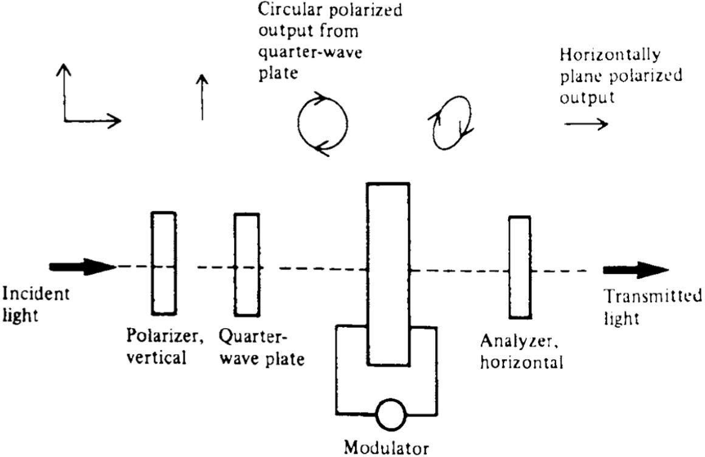
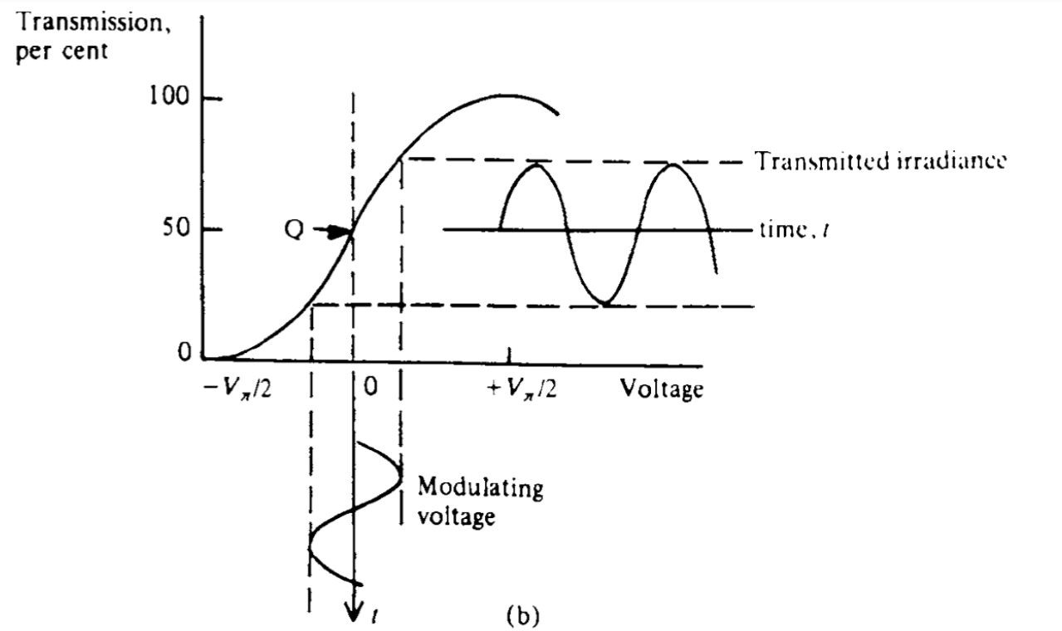
Pockels Cell Modulator

Slide 14
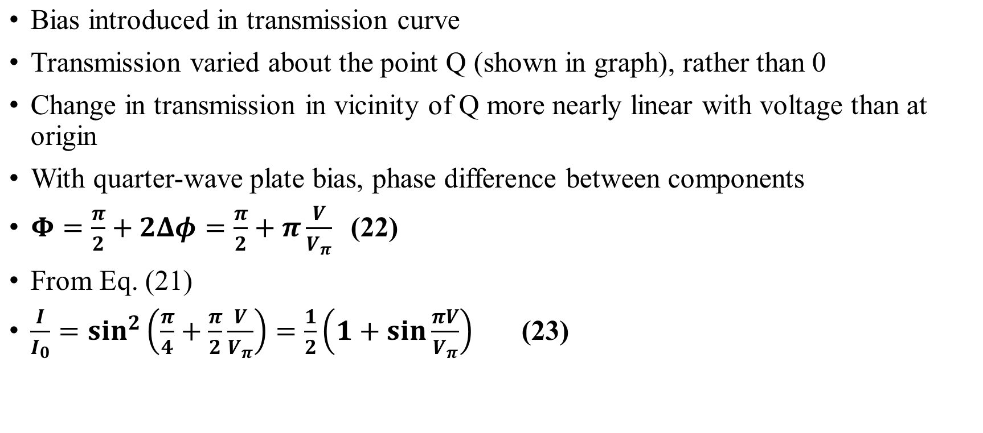
Pockels Cell Modulator

Slide 15
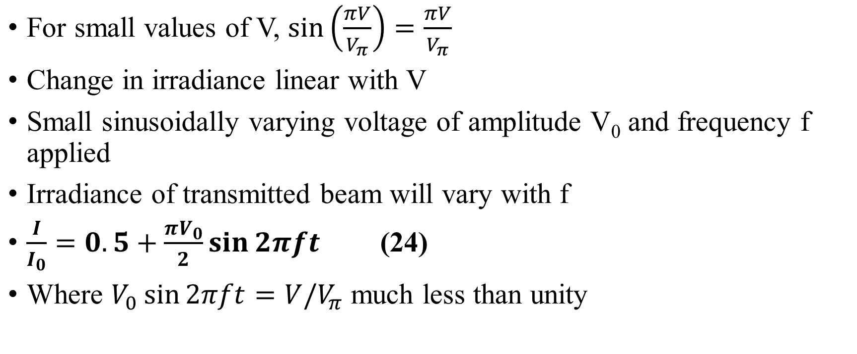
Pockels Cell Modulator

Slide 16
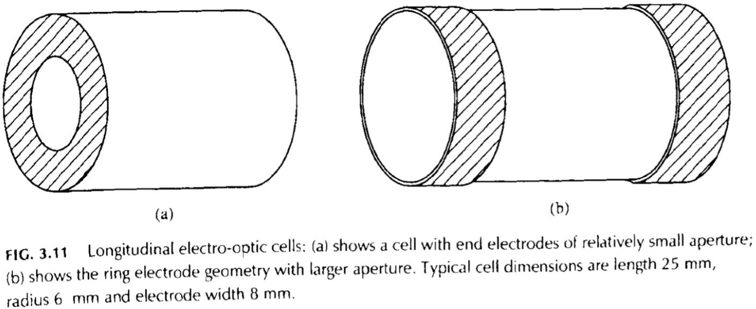
Longitudinal effect device
Electric field applied in direction of propagation of the beam
Using electrodes with small apertures or by evaporating semitransparent conducting films onto crystal surface (disadvantageous)
To avoid these, electro-optic modulator with cylindrical crystal and ring electrode geometry developed
Results in uniform transmission across effective aperture of the device

Slide 17
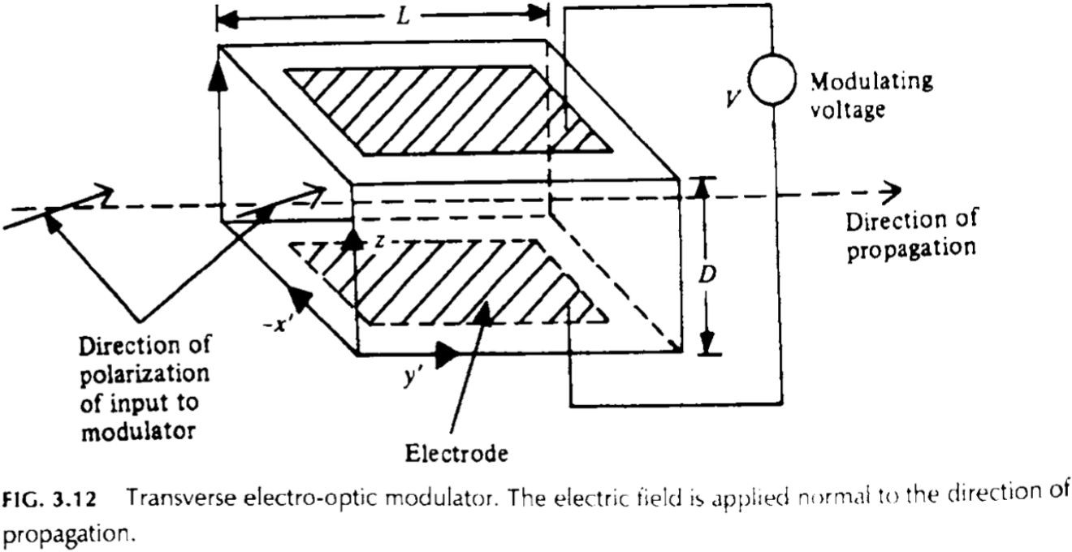
Transverse mode of operation
Field applied normal to direction of propagation
Electrodes do not interfere with beam
Phase difference proportional to electric field multiplied by the crystal length
Suppose applied field in z direction
Direction of propagation along y’ induced principal axis

Slide 18
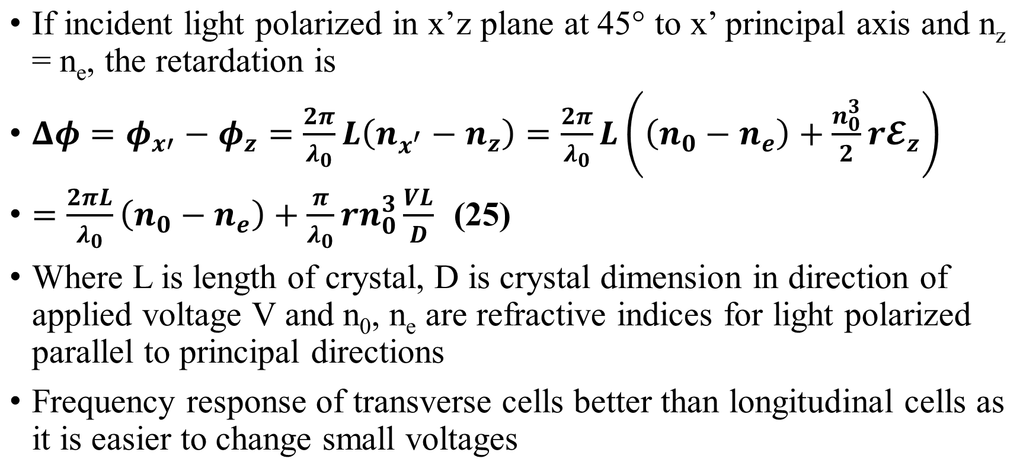
Transverse mode of operation

Slide 19
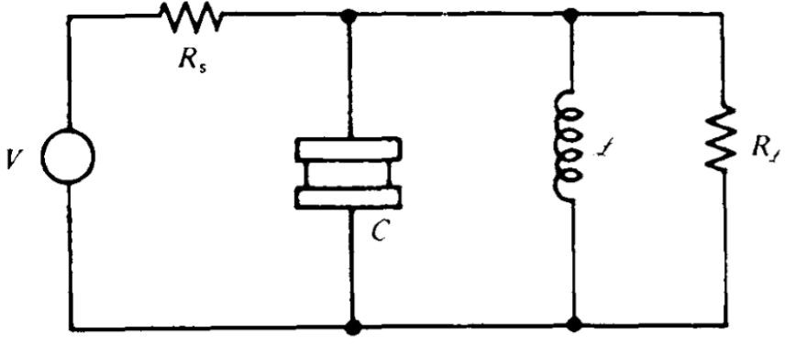
Power Requirement
Let C be capacitance due to
electro-optic crystal and R_{s} be internal resistance of modulating source
If R > (2πf C)⁻¹ where f is average
s 0 0
modulation frequency, most of modulation potential drop will be across R_{s} and therefore wasted
This problem is overcome by connecting the crystal in a resonant circuit shown in figure

Slide 20
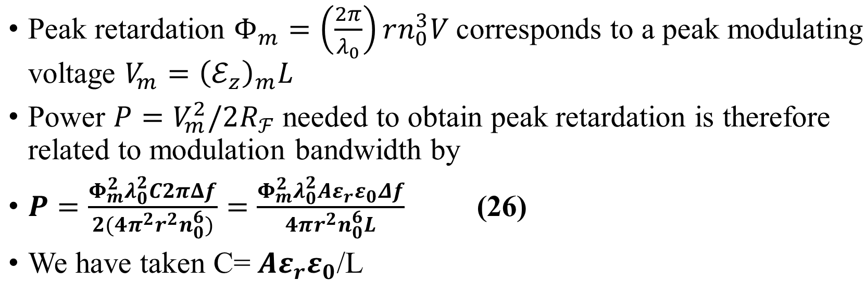
Power Requirement

Slide 21
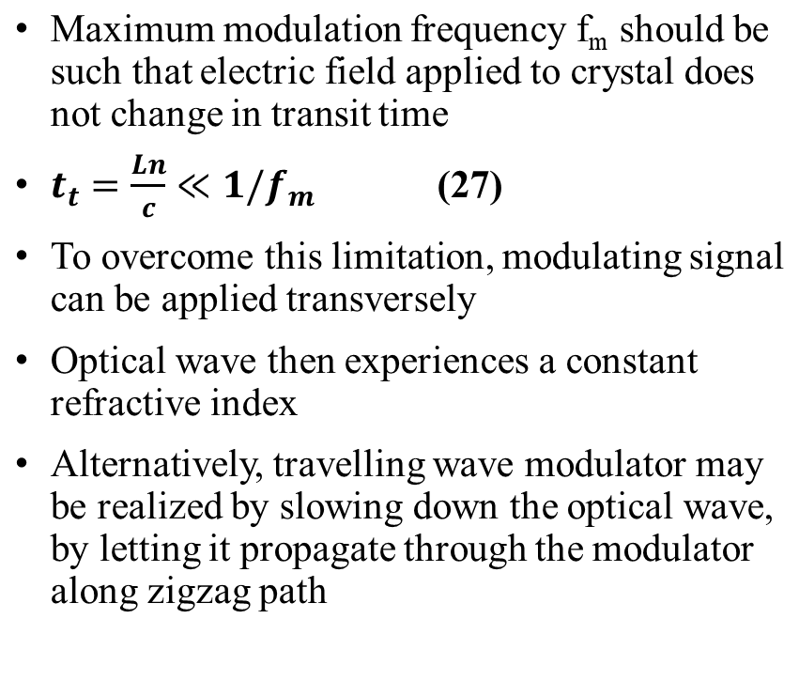
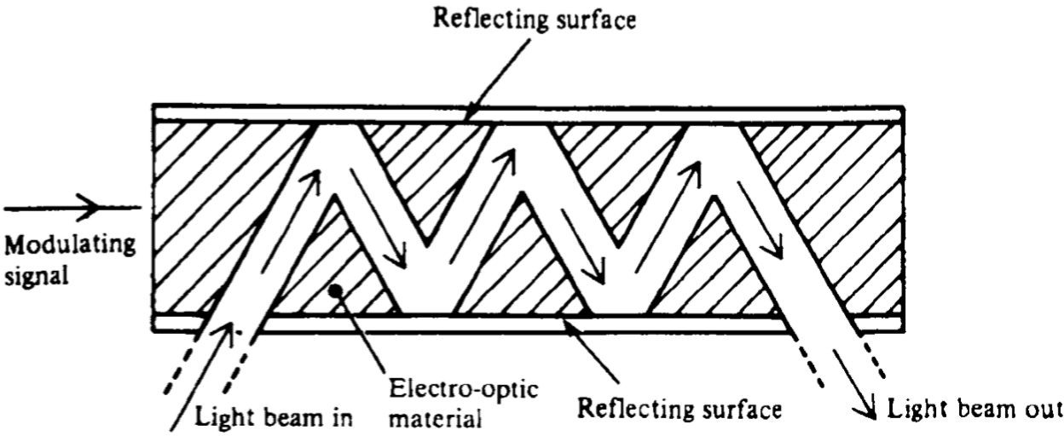
Travelling Wave Modulator

Slide 22
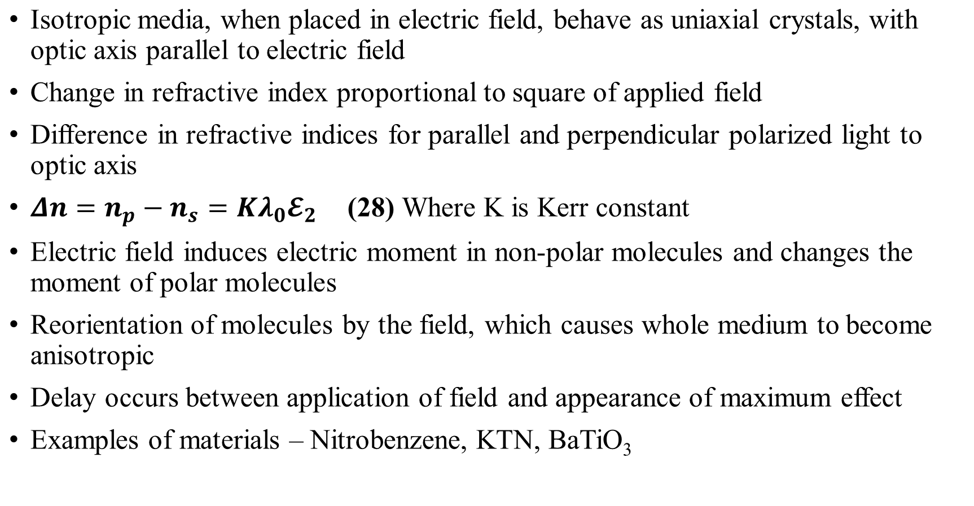
Kerr Modulator

Slide 23
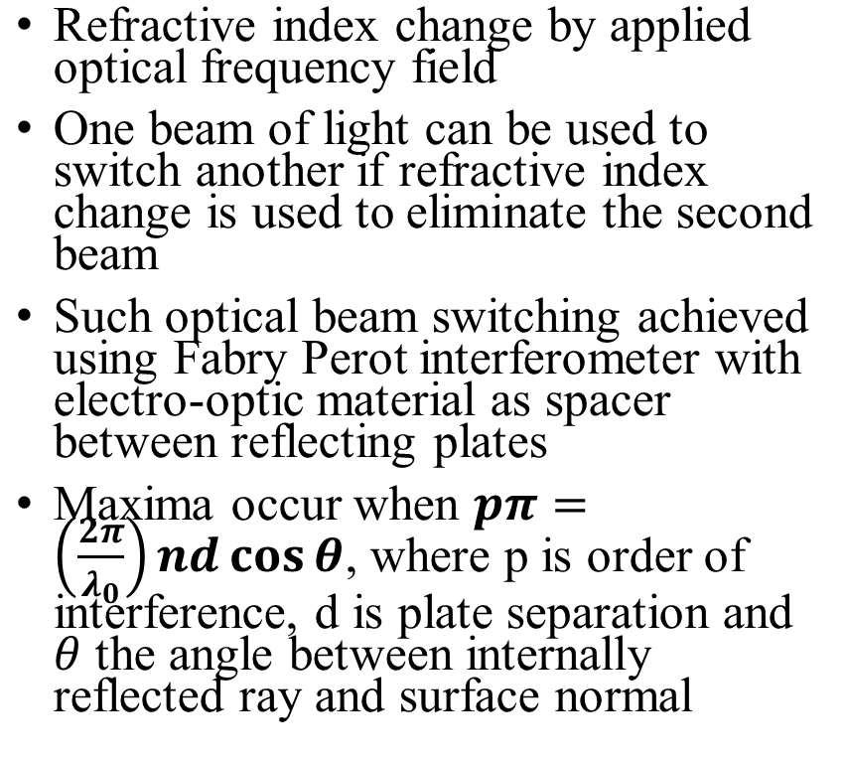
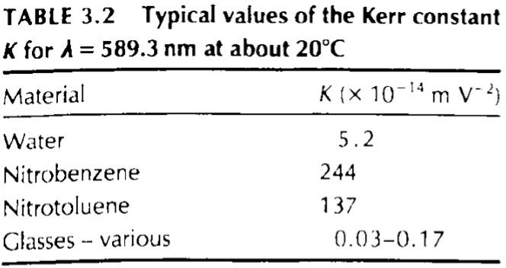
Optical Frequency Kerr Effect

Slide 24
Acoustic-Optic Modulator

Slide 25
Acousto-Optic Effect
Change in refractive index of a medium caused by mechanical strains accompanying the passage of a surface acoustic wave along the medium
Strain and hence refractive index varies periodically with wavelength Λ of acoustic wave due to photoelastic effect
Change in refractive index is proportional to square root of total acoustic power
Portions of wavefront near pressure peak will encounter higher refractive index and therefore advance with lower velocity than those portions which encounter pressure minima
Wavefront in medium acquires wavy appearance shown in figure
Acoustic wave sets up diffraction grating within the medium

Slide 26
Acousto-Optic Effect
Two Types
The Raman – Nath Regime
The Bragg Regime
The Raman – Nath Regime - The grating is so thin that the diffracted light suffers no further redistribution before leaving the modulator.
The Bragg Regime - The grating is so thick ( Grating is made up of planes rather than lines) and the diffracted light is extensively re-diffracted before leaving the acoustic field.

Slide 27
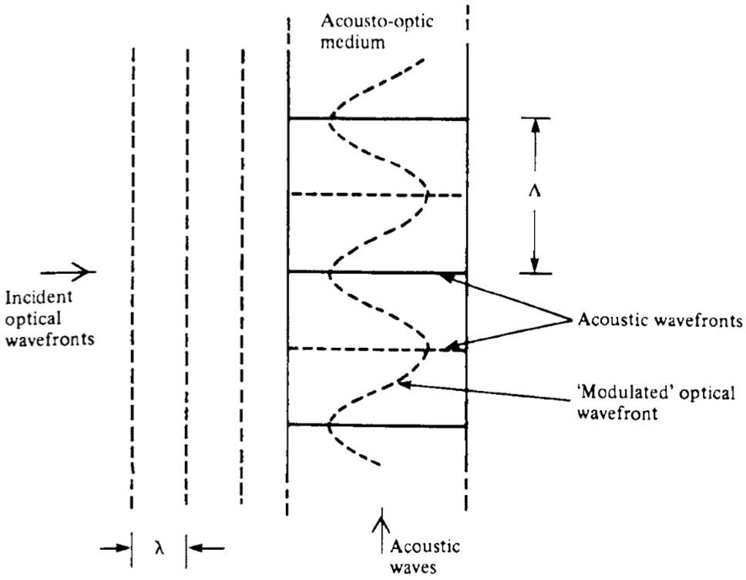
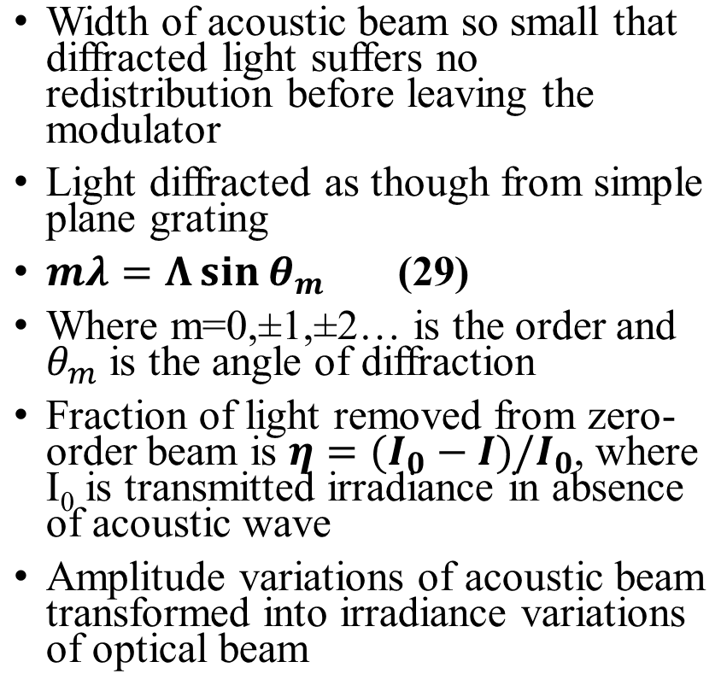
Raman-Nath Regime
•

Slide 28
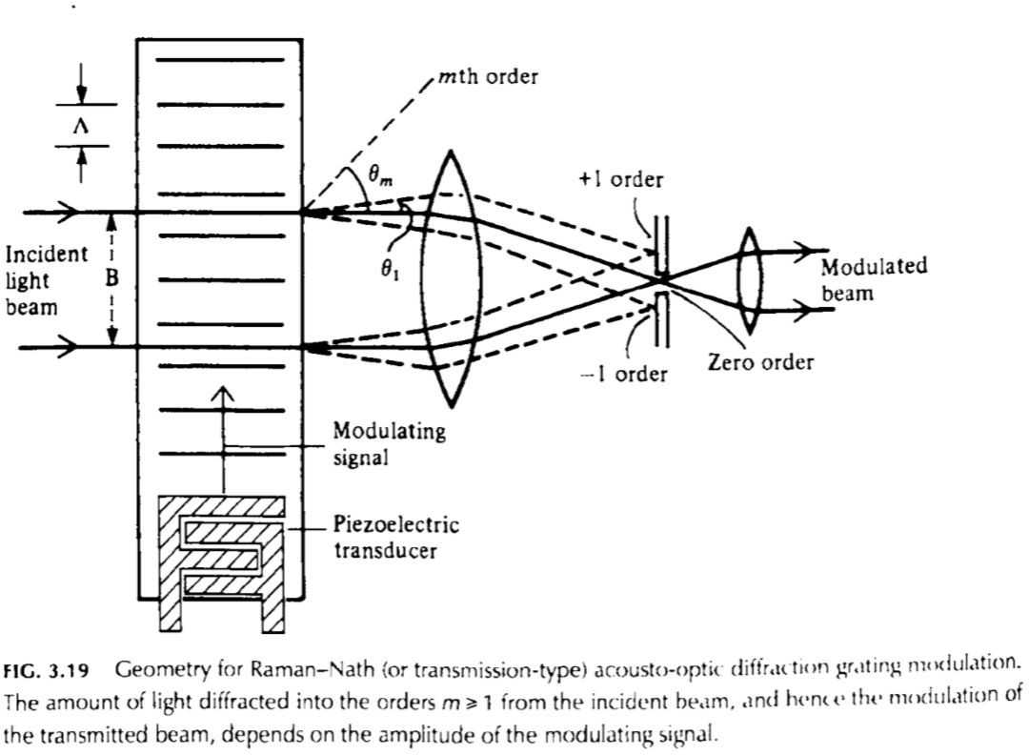
Raman-Nath Regime
The amount of light diffracted into the orders m>=1 from the incident beam
Hence the modulation of the transmitted beam depends on the amplitude of the modulating signal.

Slide 29
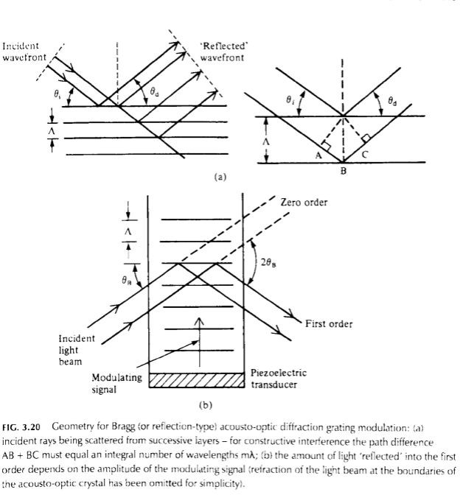
Bragg Regime
(a) Incident rays being scattered from successive layers
(For consecutive interference the path difference AB + BC must equal an integral number of wavelengths mλ

Slide 30
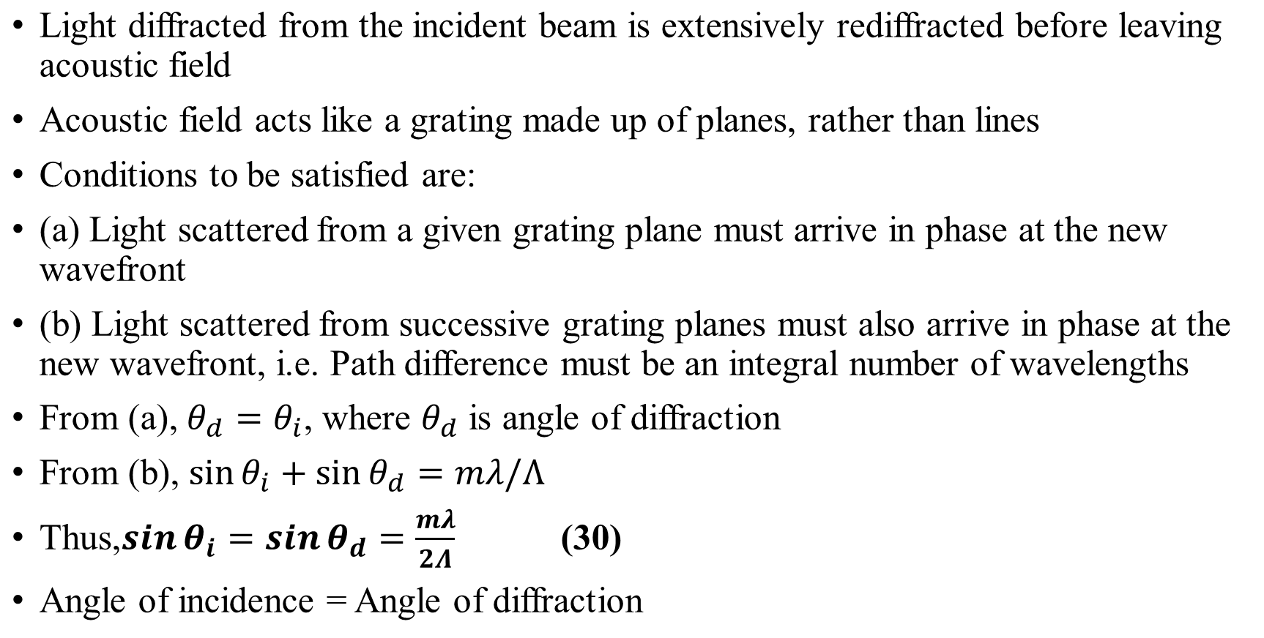
Bragg Regime

Slide 31
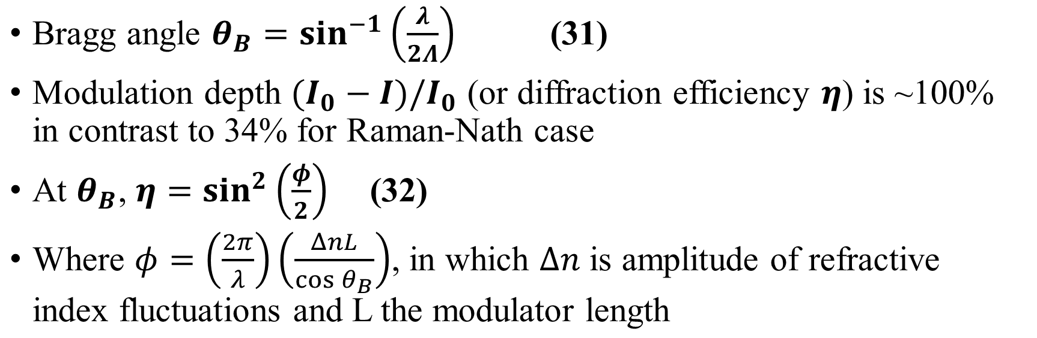
Bragg Regime
•

Slide 32
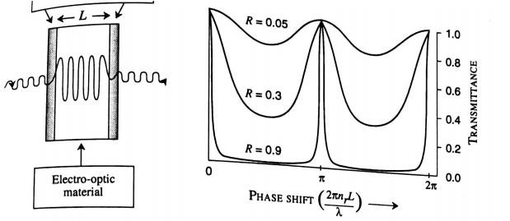
INTERFEROMETRIC MODULATORS
The phase changes produced by the electro-optic effect is used to modulate a signal.
There are many configurations that donot require polarizers, but modulate a signal through interferometric effects.
Fabry Perot Modulators or Etalon
Mach – Zender Modulators
FPM consists of two partially transmitting mirrors
enclosing an electro-optic material.

Slide 33
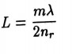
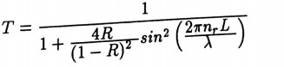
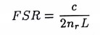
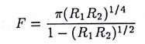
The Length of the material =
nr is the refractive index of electro optic material
λ is the free space wavelength
➢
The transmission coefficient for an etalon with mirror reflectivity R is
Free Spectral Range – The frequency difference between two successive maximas in the transmission of FP structure
Fitness – Ratio of FSR and the full width at half maximum of any transmission peak
9

Slide 34
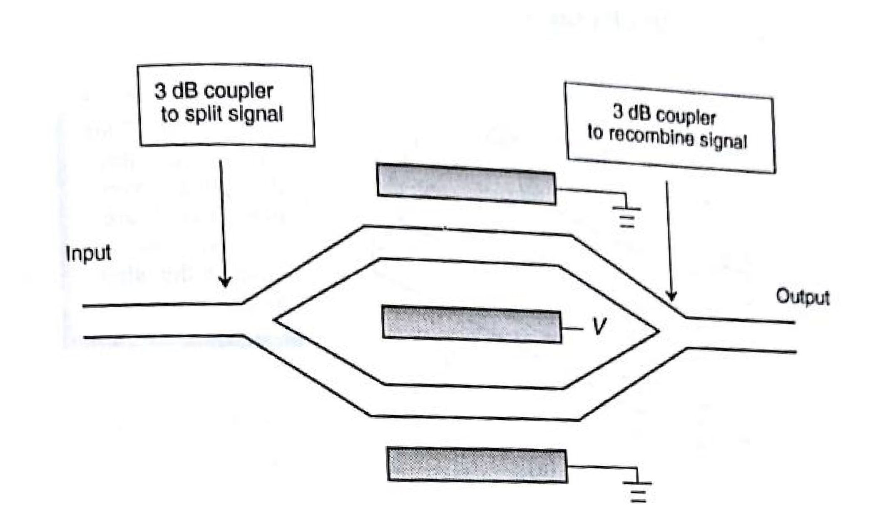
Mach – Zender Modulators
The phase modulation produced by EO effect can be used to create intensity modulation in a MZI.
An optical signal coming from a single mode waveguide is split by a 3 dB coupler.
The two split beams travel through two different guides and then recombine to produce the output.
10

Slide 35
If the optical paths in the two arms of the interferometer is an integral number of optical wavelengths, the two waves will arrive at the second coupler in phase and interfere constructively to produce high intensity.
Relative phase difference between the two waves - interfere destructively to produce less intensity.
Due to he loss in optical signal suffered as a result of the couplers, the MZ modulators don't have very high efficiencies.
If the overall phase difference between the beam travelling in the two paths is 180, then a minimum intensity will be produced.11

Slide 36
SEMICONDUCTOR OPTICAL AMPLIFIERS CHARACTERISTICS OF AMPLIFIERS
They operate by creating a population inversion, where there are more individuals in a high energy state than in a lower one.
The incoming pulses of signal on the fiber induce stimulated emission.
They saturate above a certain signal power
They add noise to the signal

Slide 37
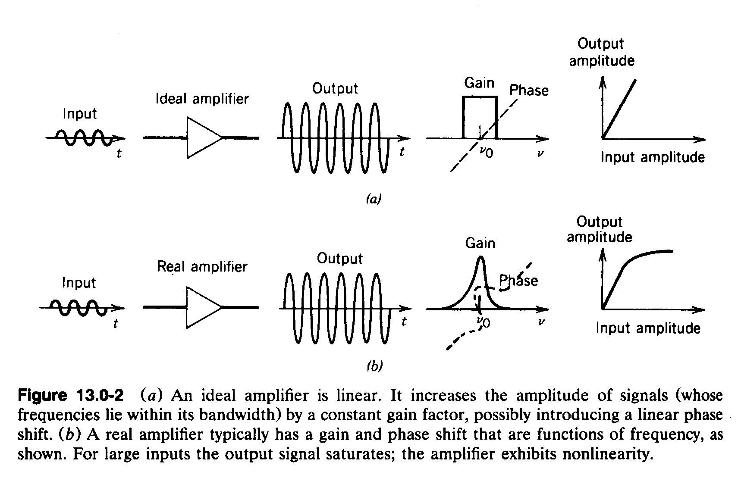
COMPARISON OF REAL AND IDEAL AMPLIFIER

Slide 38
IDEAL AMPLIFIER SYSTEM
Third excited state with very short lifetime, no fluorescence
Second excited state with very long lifetime and high cross section for stimulated emission
Pump process with large cross section
Energy gap between first and second excited states matches telecommunication frequencies
First excited state with very short
lifetime

Slide 39
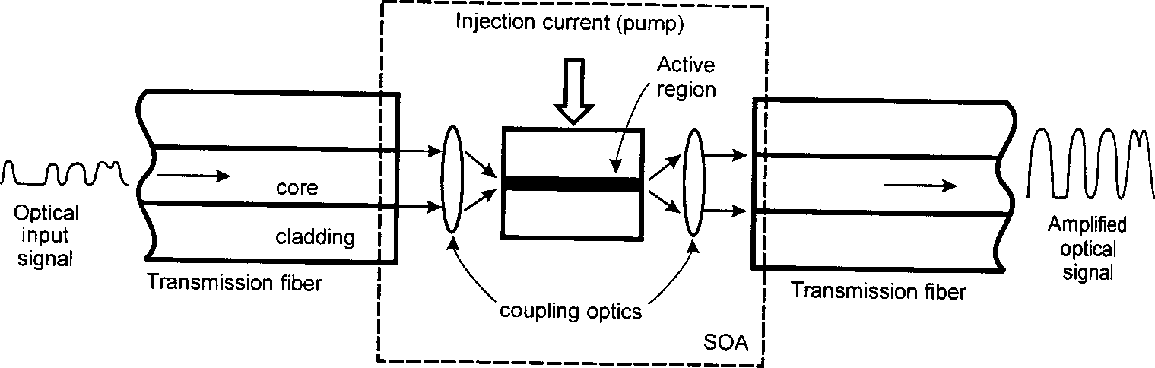
SEMICONDUCTOR OPTICAL AMPLIFIERS

Slide 40
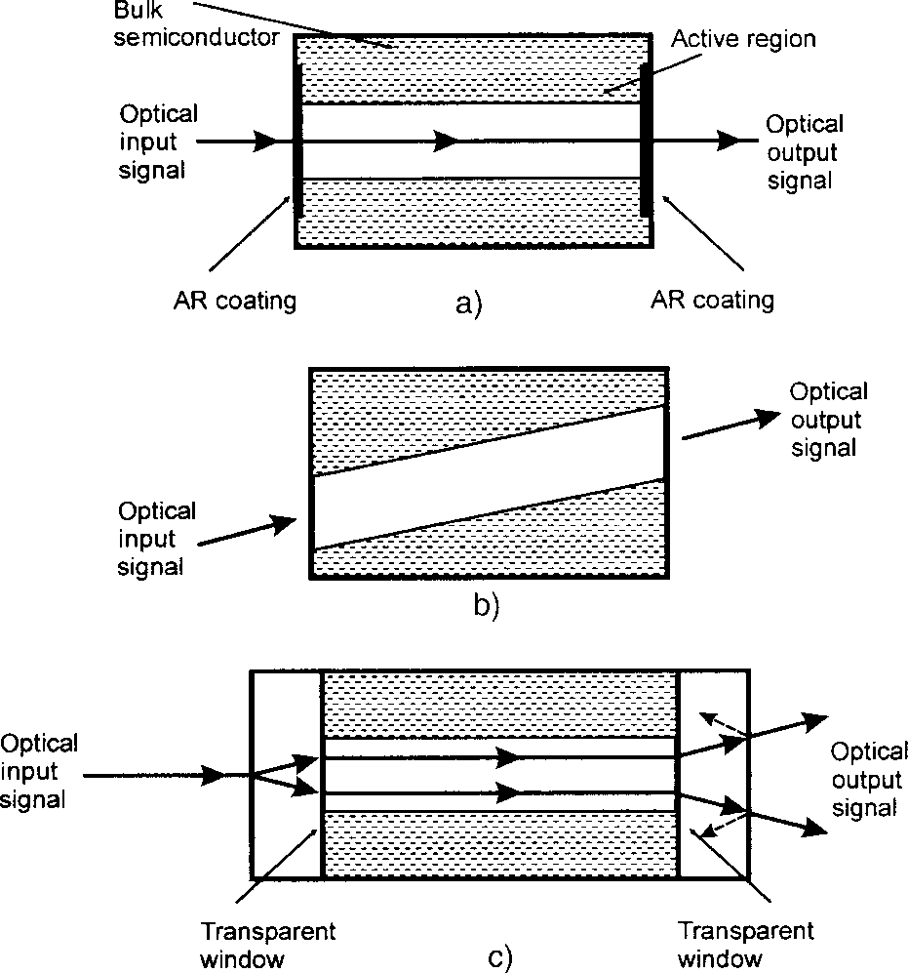
TRAVELING WAVE SOA
To make a traveling wave Semiconductor Optical Amplifier the Fabry-Perot cavity resonances must be supressed. To accomplish this the reflectivity must be reduced.
Three approaches are commonly used:
Anti-reflection coating
Tilted Active Region
Use of transparent window regions

Slide 41
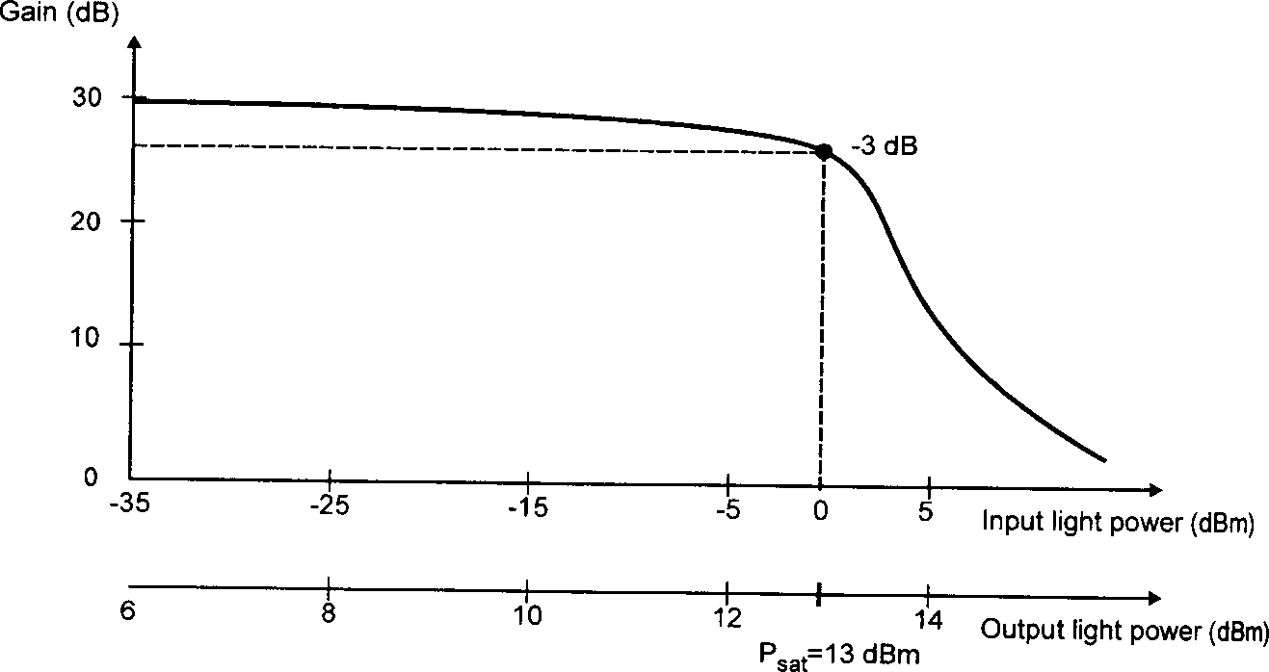
SATURATION POWER
Semiconductor Optical amplifiers saturate silmilarly to a 2 level atom
The typical saturation output power for SOAs is around 5-10 mW
Gain saturation and saturation power

Slide 42
CROSSTALK IN SEMICONDUCTOR AMPLIFIERS
If time constant for spontaneous decay of excited state is shorter than the bit duration, the population of the excited state will vary sharply with the optical power in the fiber, and gain will depend on the fraction of 1s and 0s in the data stream.
If time constant is long, then the population in the excited state will be constant, dependent upon the pump power but not the signal power.

Slide 43
SOA OPERATION
E
Conduction band
Optical transition
k
Valence band

Slide 44
SOA OPERATION
The DC current applied to the device results in electrons being pumped into the (normally empty) conduction band and removed from the (normally full) valence band. This creates the population inversion which is a pre-cursor to optical gain. When signal photons travel through the device they cause stimulated emission to occur when an electron and hole recombine.
The phase effects in these devices can be quite strong with a gain change of 3dB corresponding to roughly a phase change of p.

Slide 45
SEMICONDUCTOR AMPLIFIER ADVANTAGES
Are the right size to be integrated with waveguide photonic devices (short path length requirement)
Can easily be integrated as preamplifiers at the receiver end
Use same technology as diode lasers
Gain relatively independent of wavelength
Are pumped with current, not another laser

Slide 46
SEMICONDUCTOR AMPLIFIER DISADVANTAGES
Polarization dependence
Self-phase modulation leading to chirp
Cross-phase modulation
Four-wave mixing and crosstalk
Extremely short (ns) excited state lifetimes

Slide 47
LIMITATIONS/ADVANTAGES/APPLICATIONS
SOAs have severe limitations:
Insufficient power (only a few mW). This is usually sufficient for single channel operation but in a WDM system you usually want up to a few mW per channel.
Coupling the input fibre into the chip tends to be very lossy. The amplifier must have additional gain to overcome the loss on the input facet.
SOAs tend to be noisy.
They are highly polarisation sensitive.
They can produce severe crosstalk when multiple optical channels are
amplified.
This latter characteristic makes them unusable as amplifiers in WDM systems but gives them the ability to act as wavelength changers and as simple logic gates in optical network systems.
A major advantage of SOAs is that they can be integrated with other components on a single planar substrate. For example, a WDM transmitter device may be constructed including perhaps 10 lasers and a coupler all on the same substrate. In this case an SOA could be integrated into the output to overcome some of the coupling losses.

Slide 48
OPTICAL SWITCHING AND LOGIC DEVICES
Introduction
Why optics?
QCSE, p-i(MQW)-n Diode
The SEED: Self-Electro-Optic Effect device – a modulator
The Bipolar Controller- Modulator
Adding more functionality
Three applications
Switching Speed and Energy
A discussion on the key parameters for the success of this technology

Slide 49
Why optics?
Developing optical computers (WHY?)
Electric current flows only at about 10% the speed of light
Rate of data exchange can be FASTER
Visible-light and IR beams, unlike electric currents, pass through each other without interacting
Size of the circuit can be SMALLER
Desired features of a versatile optical circuit
Small switching energy
Less heat dissipation
A potential solution: Devices based on QCSE (Quantum Confined Stark Effect)

Slide 50
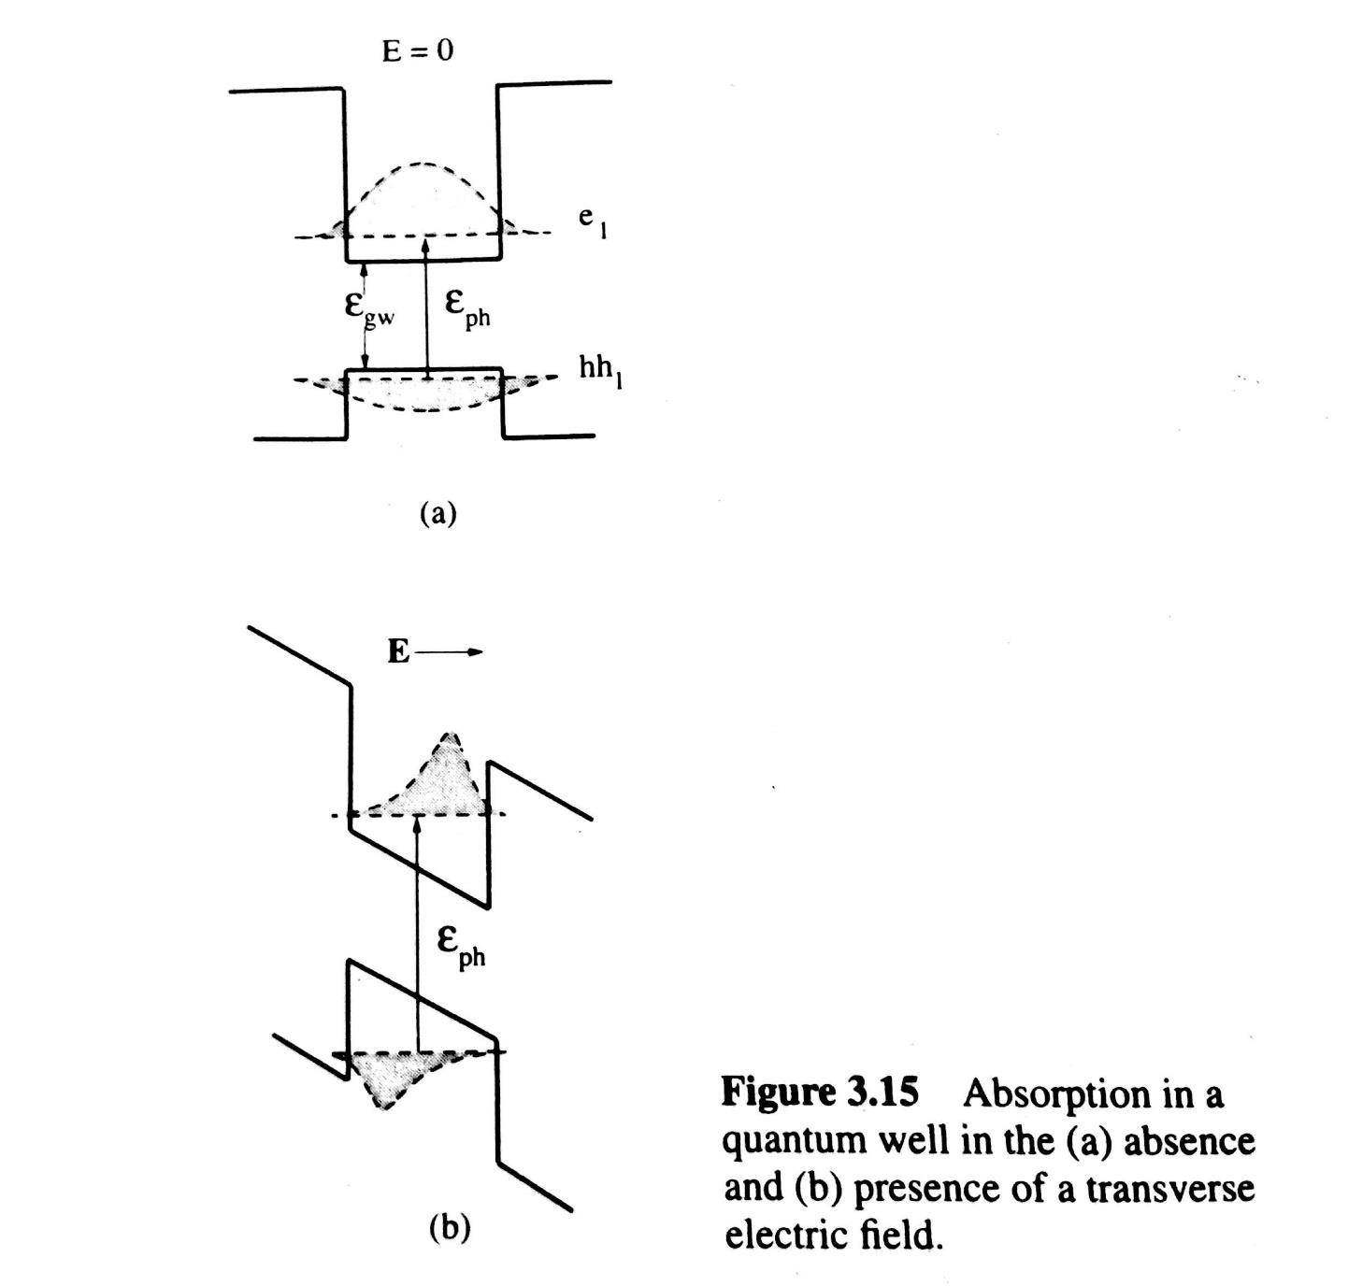






QUANTUM CONFINED STARK EFFECT
External transverse electric field applied to an MQW structure
Corresponding decrease in carrier lifetimes
Broadening of absorption spectra: red shift
Electron and hole wavefunctions move to the opposite ends of the well
The probability of carriers tunneling out of the wells goes up
Reduced overlap of the electron and hole wavefunctions
Corresponding reduction in absorption and luminescence

Slide 51
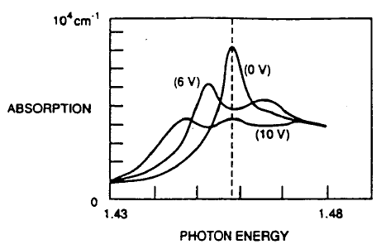
QCSE electroabsorption spectra at different voltages for a typical quantum well p-i-n diode
Quantum-well self-electro- optic effect devices, D. A. B. Miller, AT&T Bell Laboratories

Slide 52
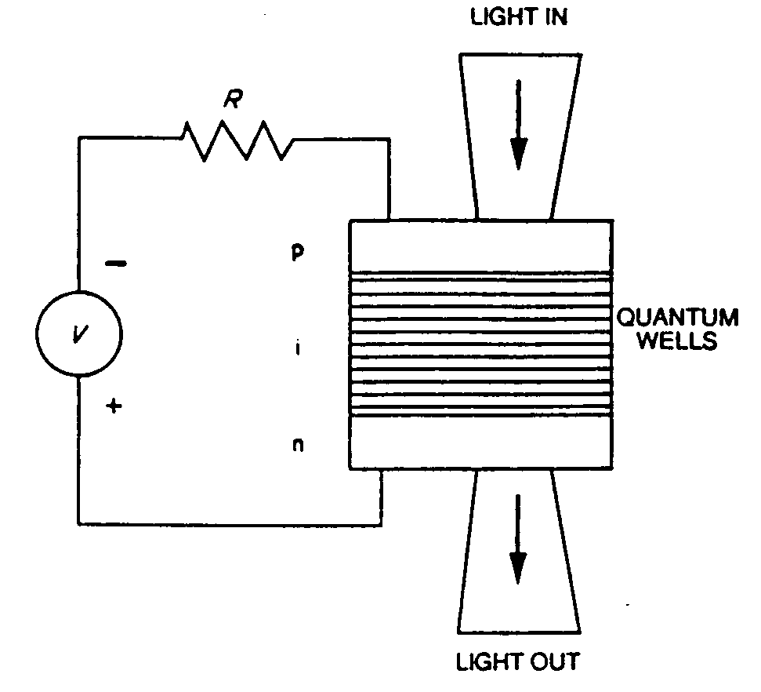
PHOTOCURRENT BEHAVIOR OF p-i(MQW)-n DIODE
Circuit schematic of a p-i(MQW)-n diode used as a modulator
The p-i(MQW)-n diode acts as an OPTICAL DETECTOR at large bias values.
Optical detection involves:
Absorption of incident photons
Recombination of some electron-hole pairs that were generated
Tunneling and thermionic emission of electrons and holes
through their barriers in opposite directions
Subsequent collection of these electrons and holes in the contact regions to generate external photocurrent, 𝑰_{𝒑𝒉}.
Quantum-well self-electro- optic effect devices, D. A. B. Miller, AT&T Bell Laboratories

Slide 53
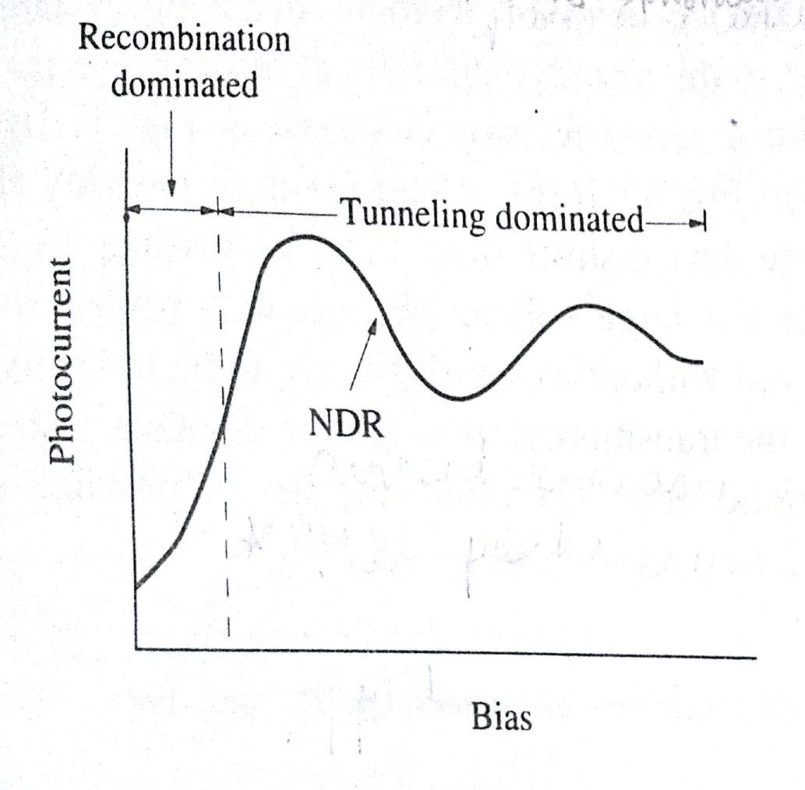
At high fields
Assuming
a uniform carrier generation rate G,
no reflection on top surface, and
an internal quantum efficiency Ƞ_{i} = 1 (approximately true for fields above 10kV/cm),
the external photocurrent is given as
Photocurrent – voltage characteristics of a p-i(MQW)-n diode
𝑞 𝑃_{𝑖𝑛𝑐} 𝛼 (𝑉) 𝑊
𝐼 =
𝑝ℎ
ℎ𝜈
where 𝑃_{𝑖𝑛𝑐} = incident optical power, 𝛼 = absorption coefficient, 𝑉 = applied bias, and 𝑊 = width of the MQW region.

Slide 54
Negative Differential Resistance
At appropriate wavelengths, a strong NDR region is observed in the
𝐼_{𝑝ℎ}- 𝑉 relationship of a p-i(MQW)-n diode.
This arises because 𝐼_{𝑝ℎ} results from the change in the absorption
coefficient of the MQW due to QCSE.
The NDR occurs where the heavy-hole (HH) and light-hole (LH) peaks cross the photon energy of the input light.
The 𝐼_{𝑝ℎ}- 𝑉 characteristics depend on the relative values of the
photon energy and the exciton resonance energy.
The NDR region can be manipulated by changing the photon energy.
Photocurrent – voltage characteristics of a p-i(MQW)-n diode

Slide 55
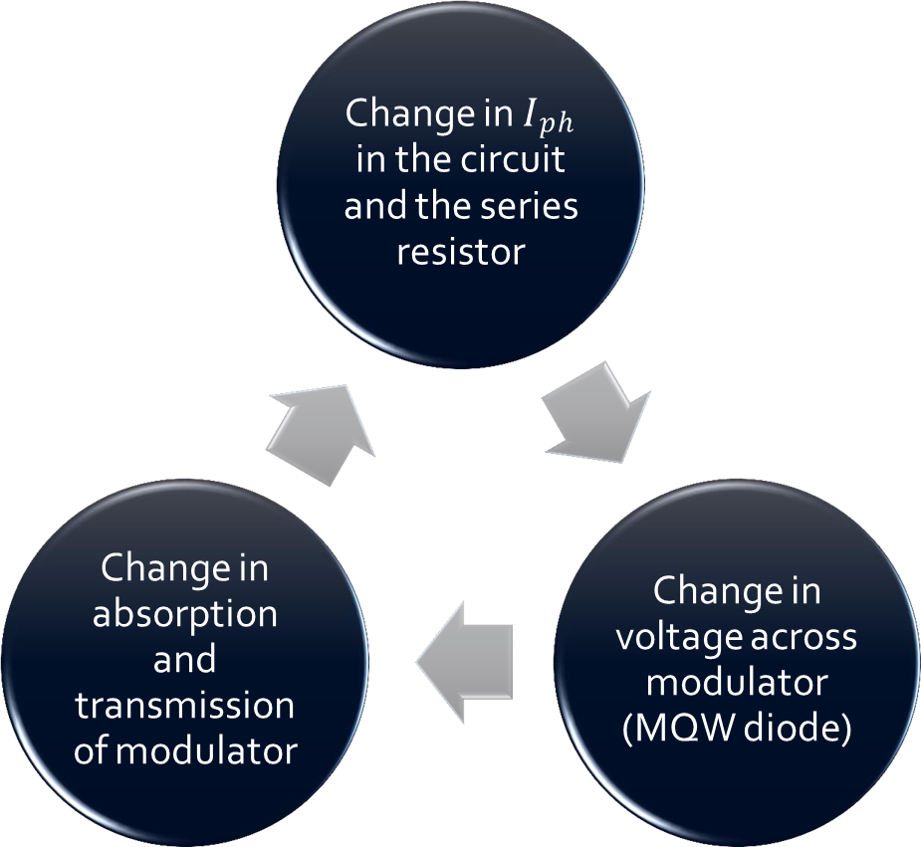
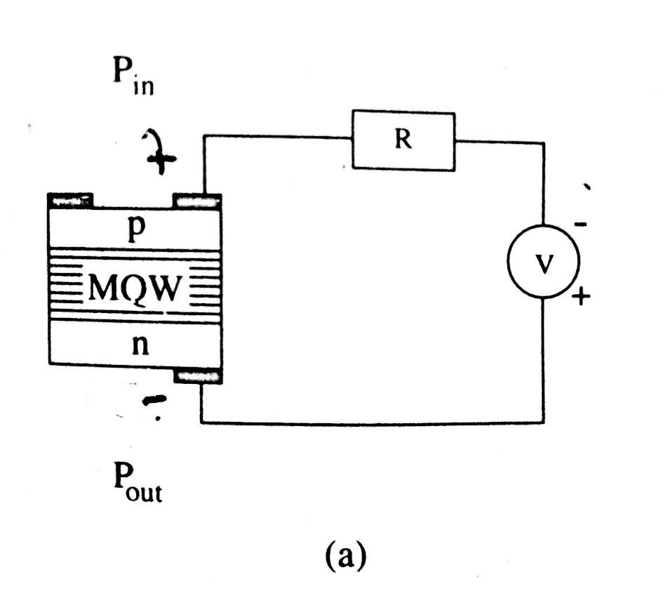
THE SELF-ELECTRO-OPTIC EFFECT DEVICE (SEED)
Reverse biased p-i(MQW)-n diode with a series resistor
Features: Exhibits photonic switching, bistability, and optically induced oscillations due to NDR in the photocurrent.
SEED circuit with feedback resistor

Slide 56
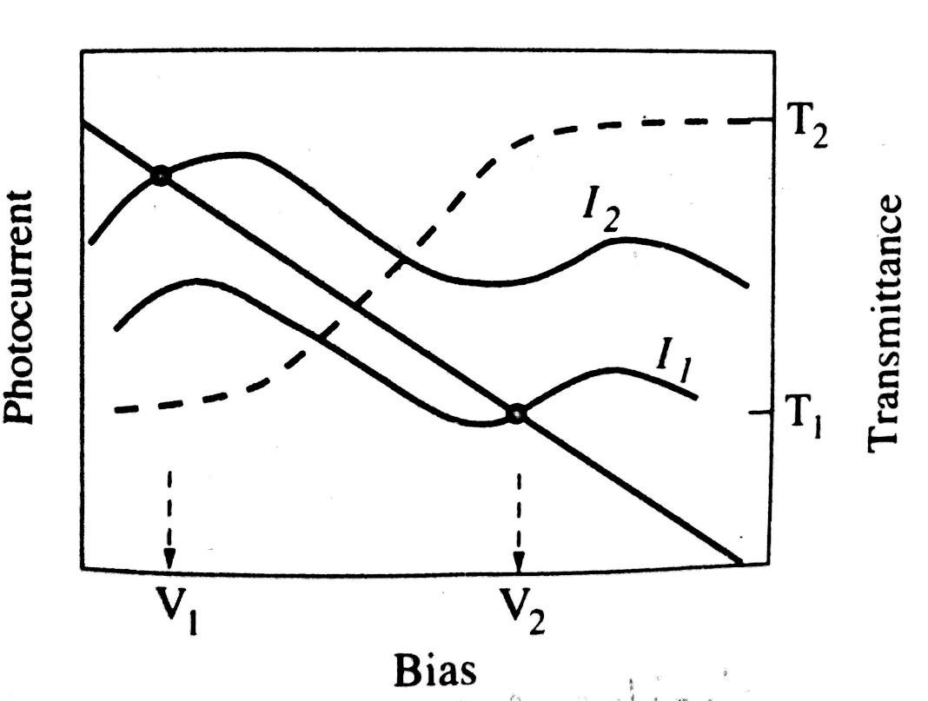
Low power input light
→ red shift in absorption spectrum due to applied reverse bias
→ most of the light is transmitted
→output increases with increasing input
Switching Action
High power input light
→ higher photocurrent
→ higher voltage across resistor
→ since diode voltage = bias voltage - resistor voltage, the reverse voltage on diode decreases
→ absorption peak shifted to higher energies
→ transmission drops
→ output power increases with further increase in input power
HYSTERESIS is observed due to asymmetric shape of the absorption resonances.
Excitonic switching property of R-SEED
Input intensity: I₂ → I₁
Voltage across diode:
V₁ → V₂
Change in transmittance: T₁ → T₂

Slide 57
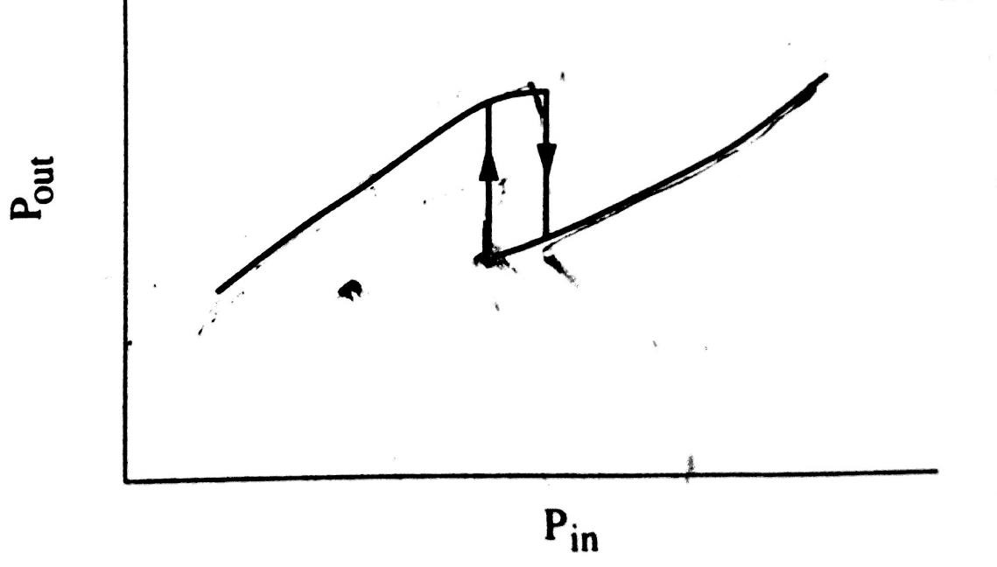
Switching Action
Low power input light
→ red shift in absorption spectrum due to applied reverse bias
→ most of the light is transmitted
→output increases with increasing input
Photonic Switching Operation
High power input light
→ higher photocurrent
→ higher voltage across resistor
→ since diode voltage = bias voltage - resistor voltage, the reverse voltage on diode decreases
→ absorption peak shifted to higher energies
→ transmission drops
→ output power increases with further increase in input power
HYSTERESIS is observed due to asymmetric shape of the absorption resonances.
Schematic illustration of photonic switching characteristics

Slide 58
Hybrid and Monolithic Integration

Slide 59
Optoelectronic Integration
Opto-Electronic Integration is a technology that combines optical component with the photonic components on a single wafer to obtain highly functional circuit.
Both optical communication systems and computing systems is the interconnect medium.
Optical Interconnect Medium – Advantages:
Can take the form of free space, integrated optical waveguides (or) optical fibres.
Optical interconnects and transmission media provide, large band width and high speed data transmission.
It is immunity to mutual interference and cross talk and freedom from capacitive loading effects.
Large bandwidth translates
(i) reduced system size (ii) reduced system power (iii) increased fan-out capabilities

Slide 60
Need for Integration
Input – output isolation not provided in optics
Difficult to focus multiple beams in a parallel system
Hence, logical to couple electronic and photonic devices (Optoelectronic integration)
Electrical interconnect media adversely affected by
Increase in reactance
Reflections due to impedance mismatch at higher frequencies
Multilevel board technology fail to perform at GHz range

Slide 61
Optical Interconnect Medium
Can take the form of free space, integrated waveguides or optical fibres
Advantages:
Large bandwidth
High speed data transmission
Immunity to mutual interference and crosstalk
Freedom from capacitive loading effects
System size reduction
Reduced system power
Increased fanout capabilities

Slide 62
Optoelectronic Integrated Circuit (OEIC)
Electrons and photons interact in a direct bandgap semiconductor to produce optoelectronic conversion
OEIC – Optoelectronic system in which multiple functions are separately performed by electronic and optical devices
Advantages:
High speed and bandwidth
Multifunction capabilities
Compactness
Low parasitics

Slide 63

Optoelectronic Integration
Optoelectronic integrated circuits (OEIC) involve the integration of electronic and optical components
Block diagram of essential elements of an OEIC

Slide 64
Optoelectronic Integration
The monolithic integration of electronic and optical devices on the same chip give the following advantages.
(i) high speed
(ii) high sensitivity
(iii) compactness
(iv) reliability
(v) low cost

Slide 65

Lay out of optical fiber link

Slide 66
Hybrid and Monolithic Integration
An optoelectronic system in which multiple functions are separately performed by electronic and optoelectronic devices. Such a system with the integrated circuit (IC) can be called as 'optoelectronic Integrated circuits' (OEIC).
Electronic functions such as switching or amplification can be combined with detection and also light transmission in integrated chip.
Need for Integration arises from a variety of needs, such as speed and bandwidth functionality and multifunction capabilities, compactness, low parasitic, etc.
OEIC will play a pivotal role in the development of future optoelectronic systems.
There are two types of optoelectronic integration.
1. Hybrid integration
2. Monolithic Integration

Slide 67
Hybrid and Monolithic Integration
Hybrid Integration
In this method, discrete devices on separate functional blocks or chips are connected using electronic (leads) or optical (fiber) interconnects.
Example:
The integration of a junction laser with its driver circuit consisting of a bipolar transistor to form a transmitter.
Advantages
The possibility of using high performance discrete devices as components.
Disadvantages
Lack of compactness and enhanced parasitic effects in terms of inter connects, bonding and lead wires.
Parasitic are considerably reduced in "flip-chip" bonding, in which two chips containing component devices and circuits are interconnected by indium bumps.

Slide 68
Hybrid and Monolithic Integration
Monolithic Integration
In this all active and passive components are fabricated on the same chip.
All parts are made with same materials and same processing steps, the hetero structures and processing steps of the different components of a OEIC can be different.
This makes the realization of high performance monolithic OEICs a real challenge.
Advantages are size reduction, reduction of parasitic and the consequent achievements of higher-circuit speed and bandwidth.
Can be achieved in either horizontal or vertical configuration

Slide 69
Monolithic Integration
Fig: Schemes of monolithic integration (a) Vertical Integration (b) planar – compatible scheme (c) planar scheme using regrowth

Slide 70
Vertical Scheme
Horizontal Scheme
Planar compatible – Both devices made from same heterostructure
Planar regrown - One device selectively regrown after growth of first device
Large freedom in choice of device heterostructures
Regrown interface can have large density of traps and other electrically active defects
Electronic and optical device structures epitaxially grown sequentially
Isolation layer in between
Lack of planarity

Slide 71
Integrated Transmitter

Slide 72
OEIC Transmitter
Transmitter circuit includes a light source (High power LED or laser)
Integration of laser with associated electronics is complicated
Laser structure is 4 μm high – Integration with incompatible heterostructure for electronic device difficult
Optical cavity in edge-emitting laser defined by two end mirrors
Electrical and optical confinement needs to be achieved in lateral dimension
Laser operation needs efficient heat sinking of whole chip

Slide 73
OEIC Transmitter
Integration of component devices to ensure higher modulation bandwidth
This is achieved by close proximity of devices and associated reduction of parasitics from devices and interconnects
However, separate optimized structures more desirable
Fig: Schematic cross-sectional diagram of a double- heterojunction bipolar transistor which also functions as a transverse-injection laser (from Y. Hasumi et al., IEEE Electron. Dev. Lett., EDL-8, 10, 0 1987 IEEE).

Slide 74
OEIC Transmitter
Early transmitter circuits had single edge-emitting laser, facet created by cleaving and integrated with a single transistor
Recently, laser facets formed on-chip by microcleaving or dry etching
Equivalent circuit of SQW-GRIN-SCH device includes 3 FETs and a 50 Ω input load resistance
Q1 and Q2 form a differential amplifier that provides common mode rejection and noise reduction
Q2 provides constant drive current, I_{B} is a dc source to bias the laser at threshold
Photodiode PD acts as monitoring device
Fig: Circuit diagram of single channel laser- MESFET transmitter (from M. Kuno et al., Appl. Phys. Lett., 49, 1575, 1986).

Slide 75

OEIC Transmitter

Slide 76
OEIC Transmitter
(a) Fabrication process of GaAs-based laser-MESFET OEIC with 3 MBE steps

Slide 77

Equivalent Circuit of Integrated Transmitter

Slide 78


Equivalent Circuit of Integrated Transmitter

Slide 79
Equivalent Circuit of Integrated Transmitter
Capacitance drastically reduced by fabricating laser diode on semi-insulating substrate
Advantage of FET in equivalent circuit is impedance matching
Modulating high-frequency input fed to gate of FET, terminated with 50 Ω resistance
Laser matched to 50 Ω input through FET, enhances modulation bandwidth
Two inputs fed to laser: DC current for biasing, AC modulating input
High frequency bias-T circuit used to separate the two inputs

Slide 80
Integrated Receiver

Slide 81
Front – End Photoreceiver
Important performance characteristics: Operating bandwidth, Sensitivity
Sensitivity: Minimum amount of optical power level needed at receiver input so that SNR is greater than given value
Photodetector and pre-amplifier considered the front – end
Rest of circuit performs equalization, pulse shaping and gain control
Fig: Block diagram of a photo receiver circuit

Slide 82
Front – End Photoreceiver
Desirable features: High quantum efficiency, low capacitance, small response time, low dark current
Three types of integration:
Low input impedance design
High input impedance design
Transimpedance design
High input impedance design requires addition of equalization circuit to extend bandwidth, due to large RC time constant
In transimpedance design, no equalization required, FET used as active feedback element to reduce overall thermal noise

Slide 83
Front – End Photoreceiver
Monolithic integration of In_{0.53}Ga_{0.47}As with In_{0.53}Ga_{0.47}As/ In_{0.52}Al_{0.48}As
MODFET by regrowth on InP
MODFET consists of layer of undoped low-bandgap material forming heterojunction with highly doped
high-bandgap material
Electrons transferred to form a quasi 2D electron gas
Electrons separated from parent donors, coulombic scattering reduced
Results in higher carrier mobility and drift velocity
Fig: Photo receiver circuit diagrams for (a) low, high, and (b) trans impedance designs.

Slide 84
Front – End Photoreceiver
Large conduction band discontinuity allows
Increased confinement of carriers in quasi 2D electron gas
Higher mobility and peak velocity in InGaAs layer
Further improvement in device performance by increasing In composition in InGaAs channel layer

Slide 85

Photoreceiver Noise Considerations

Slide 86

Photoreceiver Noise Considerations

Slide 87
Photoreceiver Noise Considerations
Improvement in sensitivity by 4 dB using 0.25 μm gate length
This is due to decrease in channel noise of MODFET
In transimpedance and low input impedance designs, thermal noise due to input load resistor is dominant
Resistance values must be kept high to achieve high receiver sensitivity

Slide 88
Slab and Strip Waveguides

Slide 89
Introduction
The aim of integrated optics(IO) is to be able to carry out as much signal processing as possible on the optical signal itself.
A family of optical and electro-optical elements in thin film planar form is used.
Most device elements are expected to be based on single mode planar optical waveguides.
One of the main difficulties has been that no one substrate is ideally suited for all the different types of device.

Slide 90
Slab and Strip Waveguides
In Integrated Optics the signal will be carried within planar waveguides in either slab or stripe form which are formed by modifying the surface of a substrate.
Planar waveguides with asymmetrical nature guides the wave where the layers above and below the guiding layer have different refractive indices
Where,
Top layer = air = refractive index (n₀)
Middle layer =Guide =refractive index (n₁)
Bottom layer =substrate = refractive index (n₂)
Fig: Slab Planar Waveguide. The guide itself formed on a substrate. The medium above the guide is usually air. The refractive indices of substrate, guide and topmost layer are n₂, n₁ and n₀ respectively.

Slide 91
Slab and Strip Waveguides
Derivation for Thickness(d) of guide
The topmost layer (of refractive index n₀) is often air and consequently has a much lower refractive index than either the guide layer (n₁) or the substrate (n₂) such a guide is thus referred to as a strongly asymmetric guide.
We suppose that the phase changes at the upper and lower interfaces are ϕ₁(0) and ϕ₂(0) respectively,
The condition for a ray to be able to propagate becomes
For a ray to undergo total internal reflection at both the upper and lower interfaces, the internal guide angle must always be greater than either of the critical angles of the upper and lower interfaces (denoted by θ_{c1} and θ_{c2} respectively).
Because we have a strongly asymmetric guide the critical angle at the upper interface will be much smaller than that at the lower.
As far as guided rays are concerned, we can assume that the internal guide angle will always be much larger than the critical angle of the lower interface, and consequently, we may approximate ϕ₁(0) by π.

Slide 92
Slab and Strip Waveguides
Derivation for Thickness(d) of guide
The propagation condition can now be written as
Following a line of reasoning, the condition for the m=1 mode to propagate becomes
In contrast to the symmetric waveguide case, it is possible for no mode at all to propagate, which happens when
Thus the condition for only a single mode to propagate now becomes
By putting the condition can be written as

Slide 93
Slab and Strip Waveguides
Derivation for Thickness(d) of guide
In terms of the guide thickness d we have
where
This final equation implies that, in contrast to the symmetrical guide case, there is a minimum thickness below which it is not possible for the guide to support a single mode.

Slide 94


The field distribution of asymmetric waveguide is illustrated below:
Slab and Strip Waveguides
A co-sinusoidal variation is still obtained across the core with the peak being displaced towards the n₂/n₁ interface.
The above analysis assumes an infinitely wide waveguide; in practice most waveguides used in IO have an approximately rectangularr cross-section so that there is confinement in both the x and y directions.

Slide 95


Two basic geometries used for making IO stripe waveguides
Slab and Strip Waveguides
Channel Waveguide
Ridge Waveguide

Slide 96
Slab and Strip Waveguides
The three main types of material which have been used as the basis of integrated optical types of waveguides are :
Various types of glass.
Materials with high electro-optic coefficients. example – Lithium Niobate (LiNbO₃)
Semiconductor materials. example – Gallium Arsenide(GaAs)
A wide variety of different techniques can be used in waveguide manufacturing, examples include:
Sputtering one type of glass onto another.
In-diffusion of a layer of titanium deposited on a substrate of LiNbO₃.
Liquid phase epitaxy.

Slide 97

Losses in Integrated Optic Waveguides

Slide 98
Guided Wave Devices
Guided wave components are required for routing optical signals on a chip and also for the functions of directional coupling, filtering and modulation.
Waveguides and couplers
Waveguide is a region of dielectric through which light is propagated, surrounded by dielectric regions or air having a smaller dielectric constant.
Techniques for Fabricating Waveguides:
To form a guide, varying refractive index regions to be created.
By introducing free carriers is the simplest technique of defining a guiding region, because in a semiconductor material with a large density of free carriers lowered the refractive index. The lowering of the refractive index due to free carriers is expressed by
Where
n_{r} - refractive index of the undoped semiconductor at a free space wavelength λo.

Slide 99
Guided Wave Devices
This change in refractive index is large enough for light confinement.
For obtaining single mode guiding and propagation , it is necessary to define the guiding region in the lateral directions also, by causing an index change.
This is achieved by three ways such as
(i) Ridge waveguide
(ii) Buried channel guide
(iii) Strip-loaded guide.

Slide 100
Guided Wave Devices
(i) Ridge waveguide
Fig: Ridge Waveguide
In this, the lateral waveguide dimensions are defined by wet or dry etching or combination of both.
A dry—etching process such as ion-milling or reactive ion etching provides control, is followed by a wet-etching process, which smoother the surface.

Slide 101
Guided Wave Devices
ii. Buried channel guide
Fig: Buried Channel by Implantation
It can be Created by various techniques such as
(i) Regrowth (simplest method)
(ii) Diffusion induced disordering .(Novel technique).
Example of Regrowth is, a GaAs waveguide is grown and defined and a higher- index AIGaAs confining layer is regrown by LPE or MOCVD.
Selective diffusion technique is a multiquantum well guiding layer is first grown epitaxially, then it is masked selectively and the regions adjacent to the guiding region are doped by implantation.

Slide 102
Guided Wave Devices
iii. Strip-loaded guide.
Fig. Strip-loaded waveguide
The formation of a dielectric or metal stripe on the guiding layer alters the refractive index of the semiconductor and confines light.
This is attributed to the spatial variation of the dielectric constant generated by stresses originating in the dielectric or metal stripe.
The strain, fields in the semiconductor, below the stripe, penetrates to a depth of 2-3 µm and therefore, it is suitable for guiding.
iv. Disordered MQW:
Fig. Disordered MQW

Slide 103
Low-Loss waveguides:
If the guides are made of high-quality, defect free epitaxial layers, then the major sources of loss are surface scattering and absorption.
Therefore, etching and formation technique become critical in the fabrication of low-loss waveguides.
Figure of merit is its loss coefficient (γ), which determines the insertion loss of a waveguide, is mainly determine by free-carrier absorption.
Therefore, material quality and processing become important in determining loss coefficient (γ)
Transmission of optical power in the guide is given by
from which the guide loss is given by
The range of Low-loss waveguides is from '0.1 to 1.0 dB / Cm'.

Slide 104
Couplers
The guided wave integrated optical circuit element is called directional coupler.
Directional coupler is used for transferring optical energy from one wave guide to another (or) from one region of an OEIC chip to another.
It consists of two parallel waveguides between which the transfer of optical energy occurs due to the overlapping of waveguide modes.
This energy exchange requires that the light propagating in both guides have same velocity and propagation vector.
If these parameters in the two channels are exactly same, then the power propagating in the two guides is given by
Where
Z direction of propagation
K coupling constant
Coupling constant (K) is given by
Where
b extinction coefficient
d separation between the guides
w width of each guide

Slide 105
Couplers
β_{y} & β_{z} mode propagation constants in the transverse and propagation directions respectively
‘Coupling length (l_{c})’ of a directional coupler is defined as the length at which the total transfer of power takes place is given by
But in real couplers, the two guides may not be same and hence the propagation constants may differ by a small amount Δβ_{z}
The coupling constant for real couplers is given by

Slide 106
Dual Channel Coupler
Fig. GaAs Dual channel single mode ridge waveguide coupler
Curved sections of guides are important elements of integrated optics.
Sharp bends constitute a large radiation loss.
For the bends to loss-free, the radius of curvature at the bend must be larger than 'λ', the wavelength of light propagating in guide

Slide 107
Active Guided Wave Devices
Active guided wave components can be integrated in OEICs with active optoelectronic devices.
Examples of active guided wave devices are
1. Laser
2. Electro optic modulator
Active Guided wave devices are used as
1. Modulators
2. Interferometers and
3. Filters

Slide 108
Mach – Zehnder Interferometer

Slide 109

Mach – Zehnder Interferometer
A simple guided wave modulation/switching device based on the electro-optic effect is the Mach-Zehnder interferometer.
Fig. shows the schematic diagram of guided wave Mach-Zehnder interferometer with input and output 3-dB couplers.
Fig: Schematic of guided wave Mach – Zehnder interferometer with input and output 3-dB coupler

Slide 110
Mach – Zehnder Interferometer
Operation:
The incoming optical beam is split equally between the two branches of the input coupler.
Then recombined at the coupler at the other end.
To reduce bend losses, care has been taken in materials growth and processing.
With no applied bias to the Schottky diode, the phase shift in the two arms is equals and at the output coupler the two wave interfere constructively and all the power appears at the output.
To analyze the switching characteristics of a device, assume the electric field of the input to one arms has unity amplitude and zero phase.

Slide 111
Mach – Zehnder Interferometer
According to coupled mode theory, the fields at point a are given by
At point b, the field is phase shifted due to propagation over the length L_{a} and
In the second equation, the electro optic effect is taken into account due to the bias V applied to
the Schottky diode over a length l.

Slide 112
Mach – Zehnder Interferometer
Therefore, unequal lengths l₁ and l₂ will introduce a phase difference between E₁ andE₂
While the electro-optic effect introduces an additional phase shift.
Where, d → thickness of the wave guide.
The output coupler recombines the field E_{1b} and E_{2b} to give the field output of arm 1 as

Slide 113
Mach – Zehnder Interferometer
The output intensity from the arm, is obtained by taking square of the magnitude of the field.
Similarly, we can obtain the output from arm 2
If the device is loss less, then the sum of I₀₁ and I₀₂ is equal to the input intensity regardless of the relative phase shift between arms 1 and 2.
The I₁=l₂ and no bias applied, then I₀₁=1 and I₀₂=0

Slide 114
Mach – Zehnder Interferometer
If the phase shift produced by the application of a bias π and Δϕ_{l} = 0, then I₀₁ = 0 and I₀₂=1.
The modulation index in this case is 'unity' and corresponding bias is given by
subscript π denotes a 'half wave phase shift' and V_{π} is also called 'half wave voltage'.

